Slide 1
PILLBOT: VOICE CONTROLLED ROBOT FOR DELIVERING MEDICINES
Presented by:
Jayaashree P - 2019105541
Shwetha A - 2019105576
Harini V - 2019105013
Lavanya S - 2019105024
Project guide:
Dr. Jeyalakshmi V
Project coordinators:
Mrs. P. Steffi Snow
Dr. O. Uma Maheshwari
Department of ECE
College of Engineering,Guindy

Slide 2
OBJECTIVE, MOTIVATION and LITERATURE SURVEY
To issue voice commands via App in mobile to control the navigation of the robot.
For supporting people with disabilities in performing everyday tasks with little effort.
To supply pills in quarantined rooms ~ Pillbot
AUTHOR AND YEAR | PAPER TITLE | CONTRIBUTION
Dipesh Diwakar, Ashok Choudhary, Ashu Singh, Prof Nazish Fatima, 2019 | Voice Controlled Robotic Vehicle | The integration of control unit with Bluetooth device is achieved using a Bluetooth module to capture and read the voice commands. The robotic vehicle operates as per the command received via android device, for this Arduino is integrated in the system.
Archana Ashok Gajare, Amruta Anil Chandawale , Priyanka Dhanaji Agalave , Pallavi Prabhakar Gurav , Tejaswini Ravindra Patil, 2021 | ANDROID CONTROLLED ARDUINO BASED VOICE CONTROL ROBOT | An Android application in the system is used as a medium to transmit human commands to the microcontroller. The controller interface can be accessed via the Bluetooth module via the UART protocol.
R. Rajalakshmi,Y. Sushma, T. Sowmya 2021 | Voice Controlling Robotic Vehicle by Bluetooth Module | Voice controlled robotic vehicle-advanced robotic vehicle operated by client commands. An ARM series microcontroller inter connected with the Arduino.This Robotic car is connected to mobile App like AMR-voice which makes the robotic vehicle to move after getting the command from the user.

Slide 3
FLOW OF PROJECT WORK
Creation of App in MIT APP inventor and downloading it to mobile
Chassis assembly, placement of components and connections
Arduino coding to navigate the bot.
Debugging connections, code, app for final recognition of commands and bot movement
Final testing and debugging.
Use of IR sensor to trace the path
Pillbot designing and building above the base robot

Slide 4
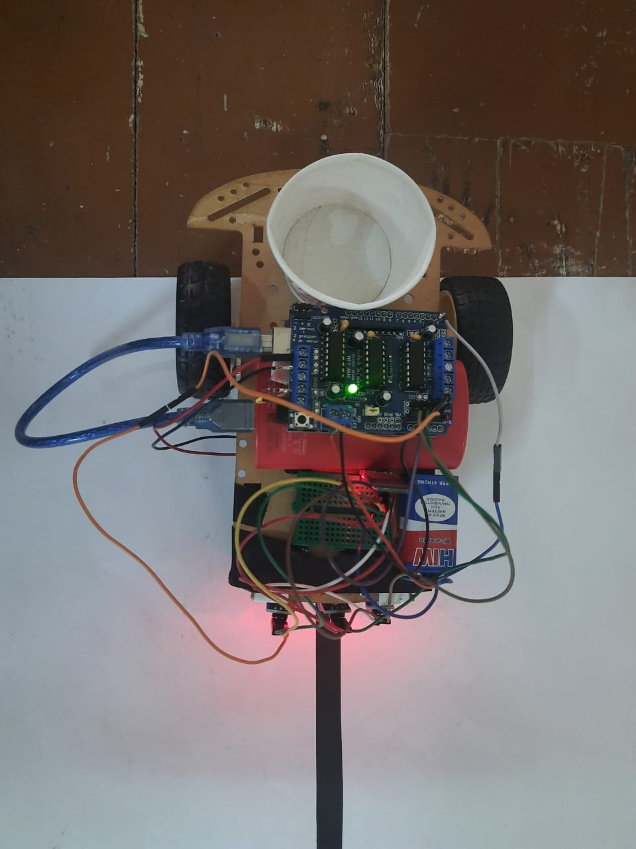
COMPONENTS
HARDWARE
Arduino ATmega1280
HC-05 Bluetooth module
IR Sensor
L293D Motor driver shield
Chassis kit
SOFTWARE
MIT App Inventor
Arduino IDE
EasyEDA

Slide 5
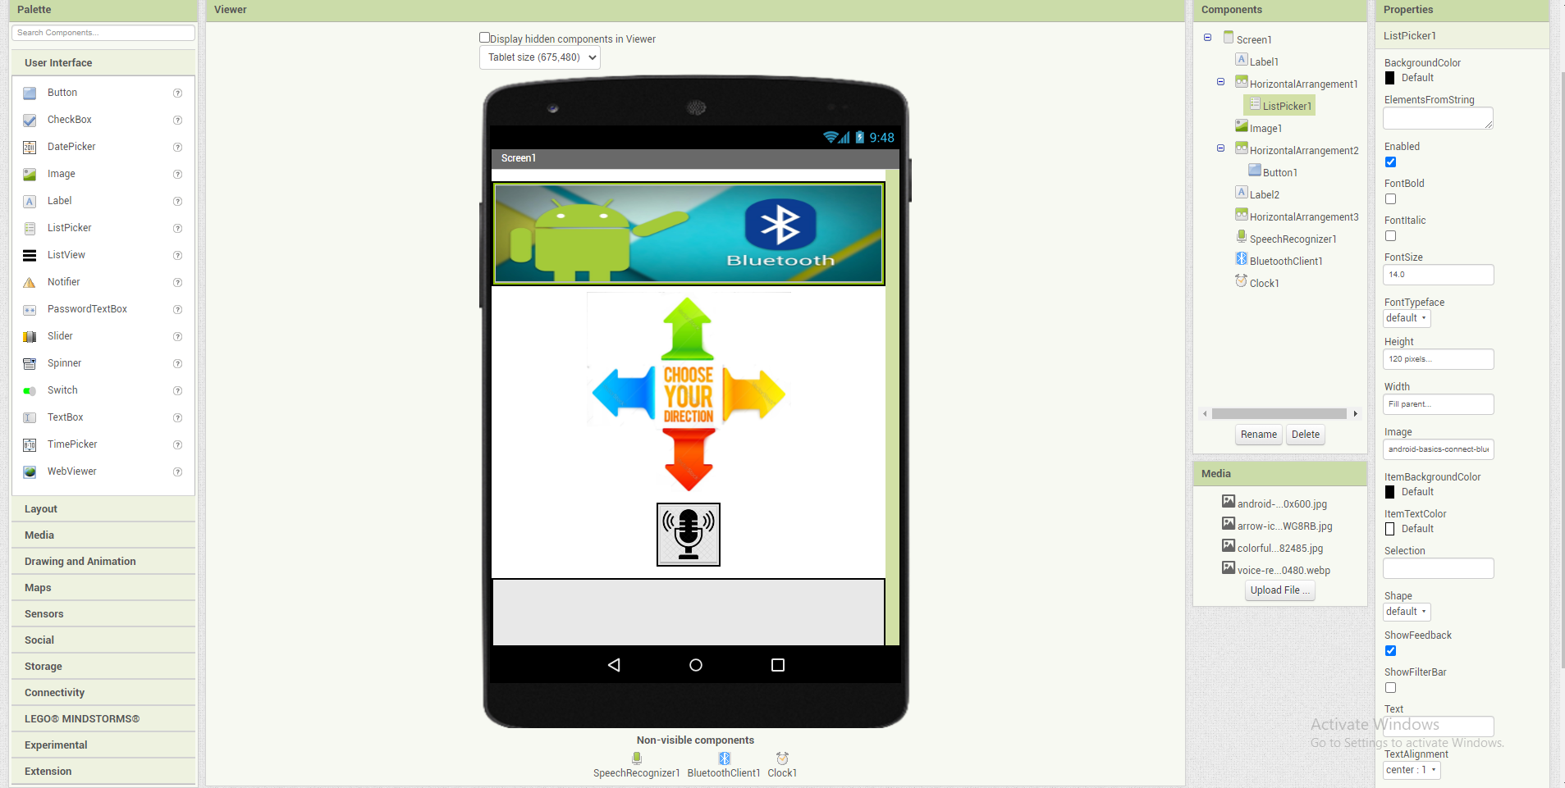
Android Application Design using MIT App Inventor

Slide 6
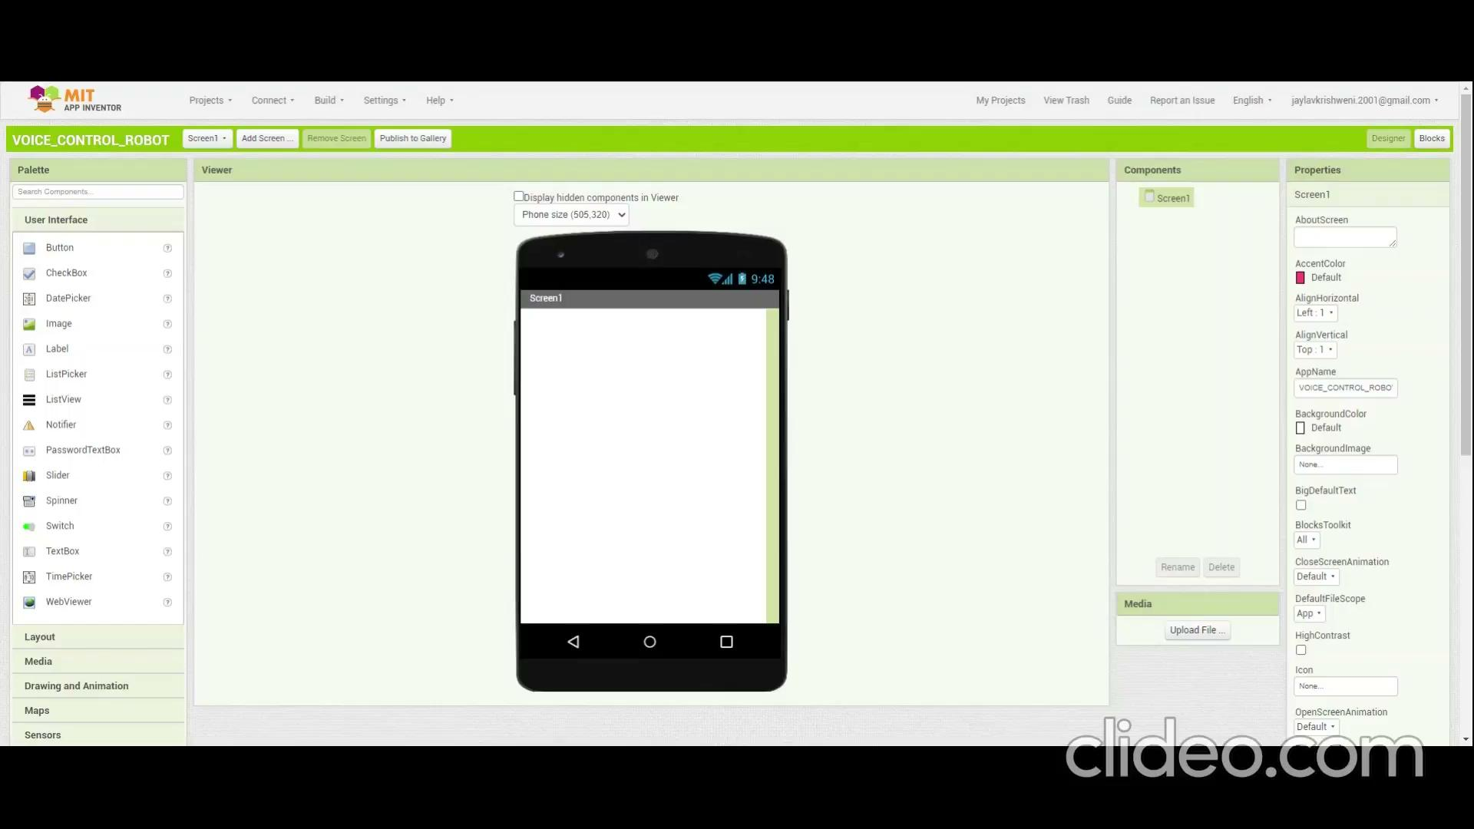

Slide 7
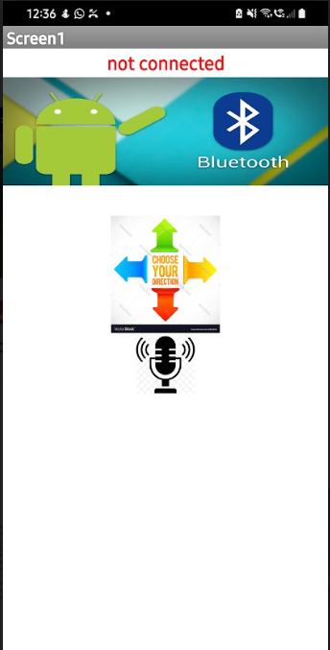
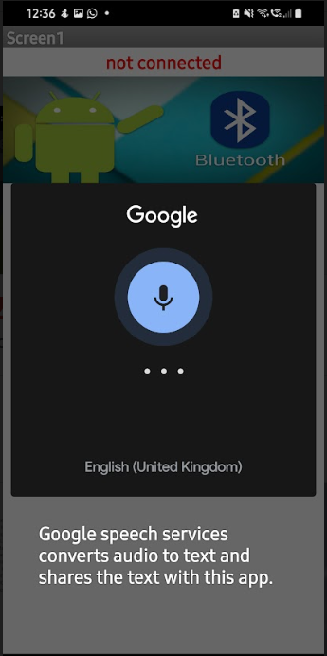
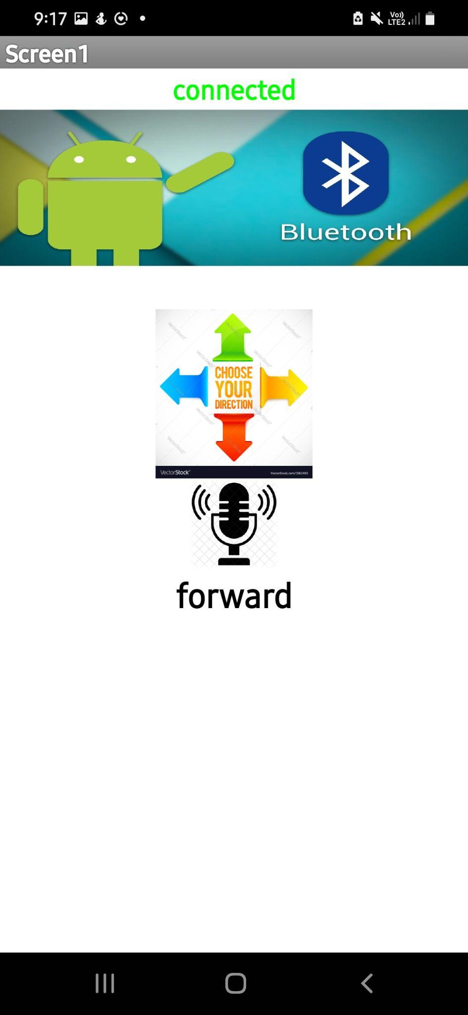
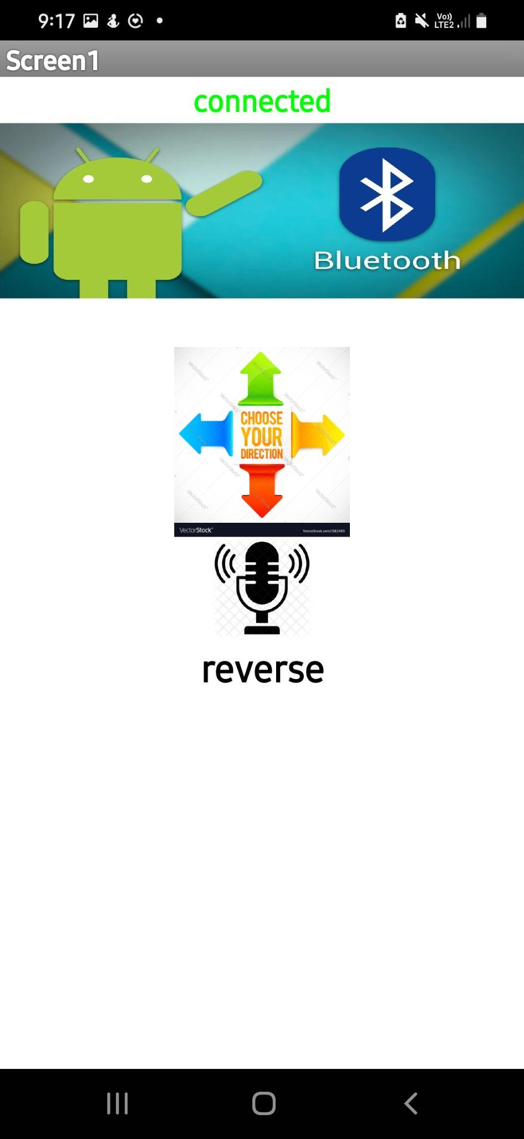
Android Application Screen
Direction detection
On clicking the voice input icon

Slide 8

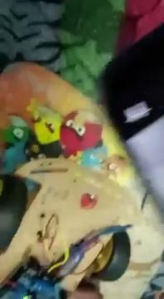
ROBOT WORKING VIDEOS
Left and Right
Forward
Reverse

Slide 9
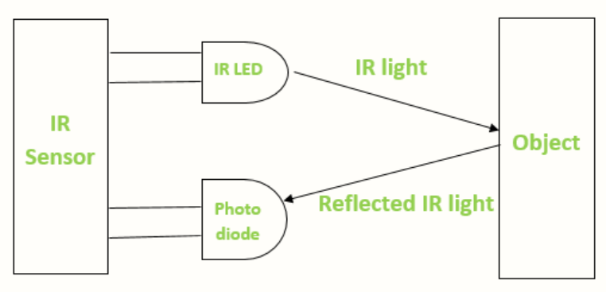
IR SENSOR
IR sensor is an electronic device, that emits the light in order to sense some object of the surroundings. It can measure the heat of an object as well as detects the motion.
The emitter is simply an IR LED and the detector is simply an IR photodiode . Photodiode is sensitive to IR light of the same wavelength which is emitted by the IR LED. When IR light falls on the photodiode, the resistances and the output voltages will change in proportion to the magnitude of the IR light received.
When the IR transmitter emits radiation, it reaches the object and some of the radiation reflects back to the IR receiver. Based on the intensity of the reception by the IR receiver, the output of the sensor defines.This is the underlying working principle of the IR sensor.

Slide 10
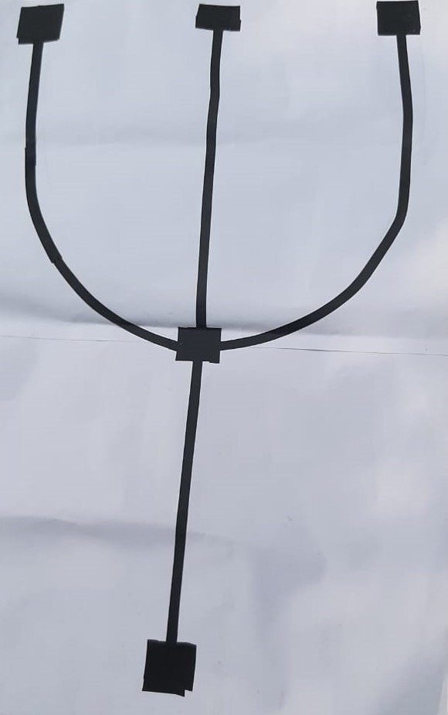
PILL BOT
According to the command given in arduino the robot has to navigate to the position. In our case we have given command for 3 rooms where the necessary medicines/ pills must be delivered to the patient in that particular room.
Room 3
Room 2
POSITION MAP
Room 1
Home Position
PILLBOT SETUP

Slide 11
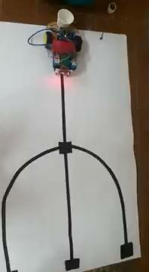
BOT MOVEMENT ACCORDING TO INPUT COMMANDS

Slide 12
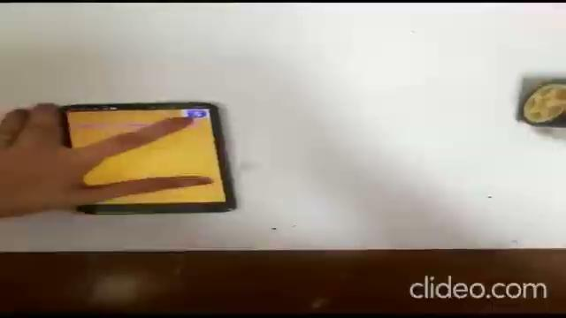
BOT MOVEMENT ACCORDING TO INPUT COMMANDS

Slide 13
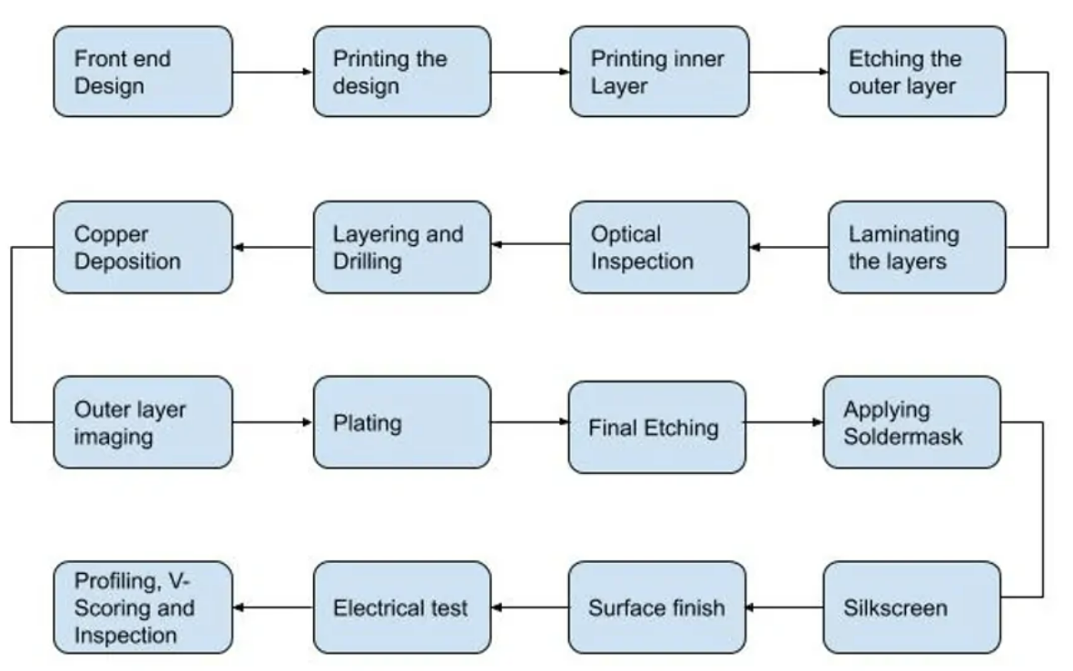
Various Steps in PCB Design and Manufacturing

Slide 14
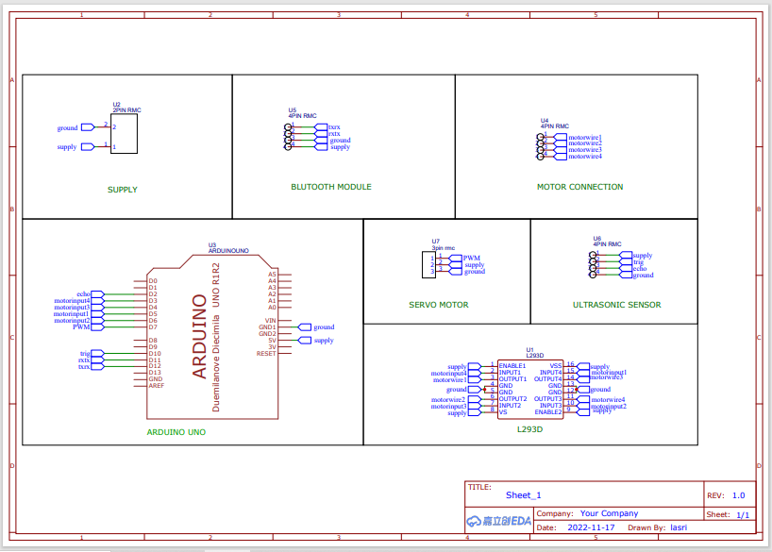
PCB DESIGN SCHEMATIC (using EasyEDA)

Slide 15
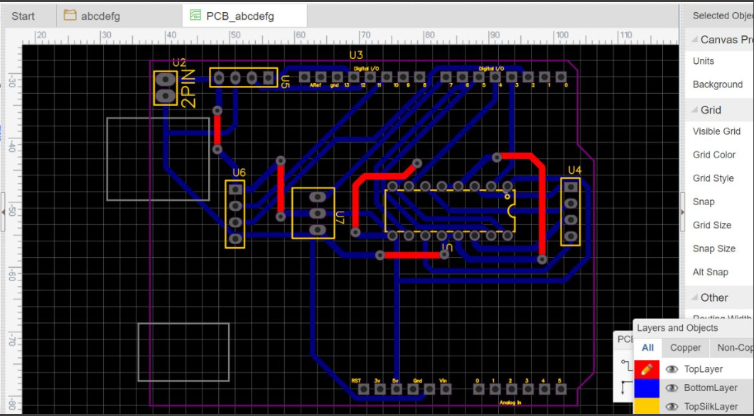

Slide 16
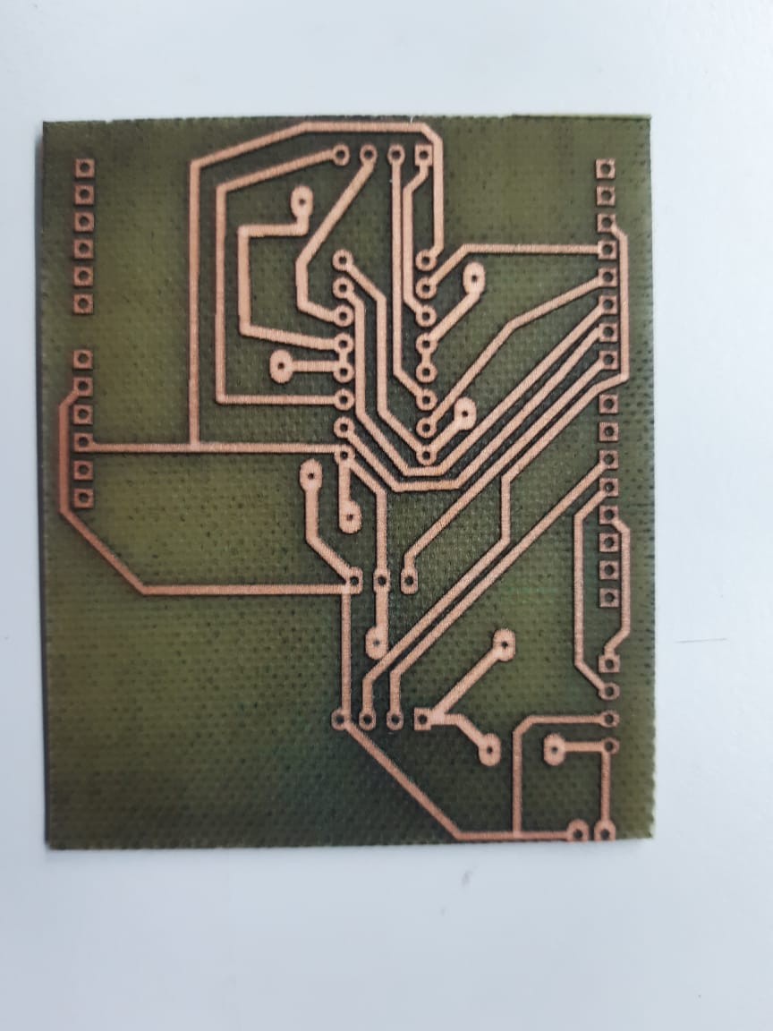
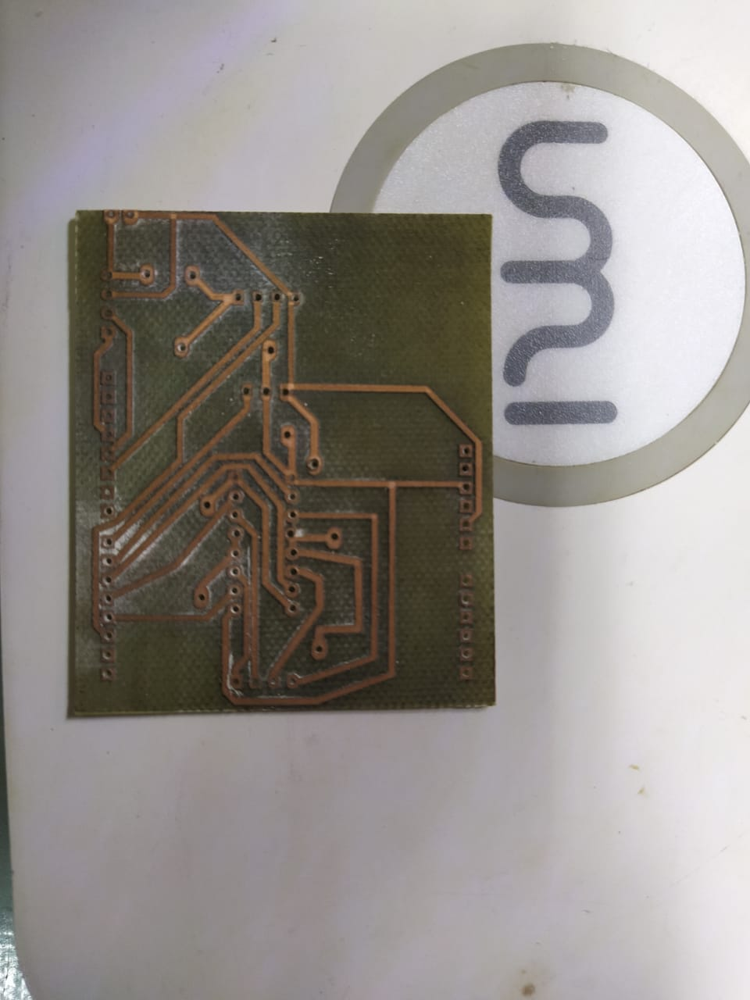
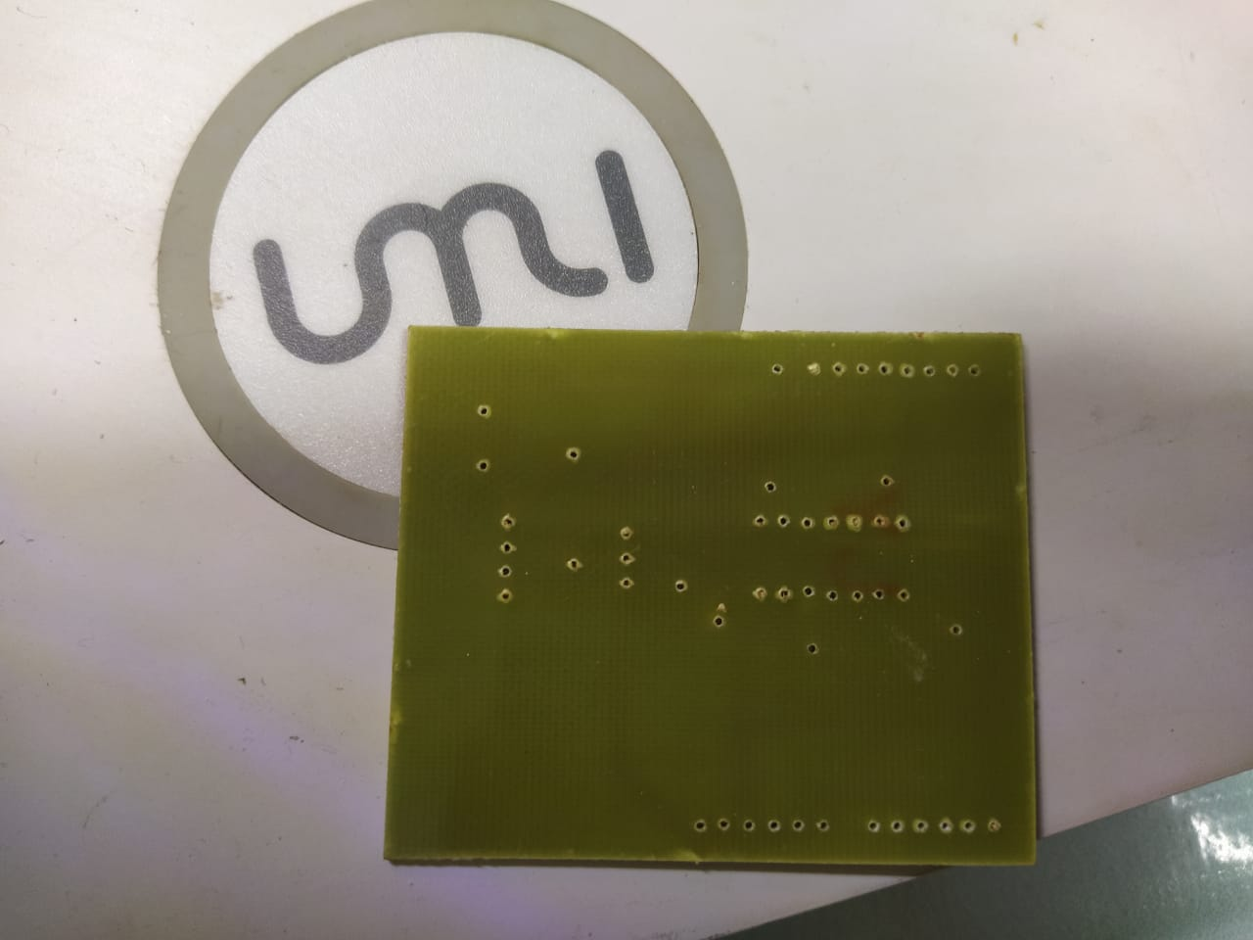
PCB LASER ETCHING AND DRILLING

Slide 17
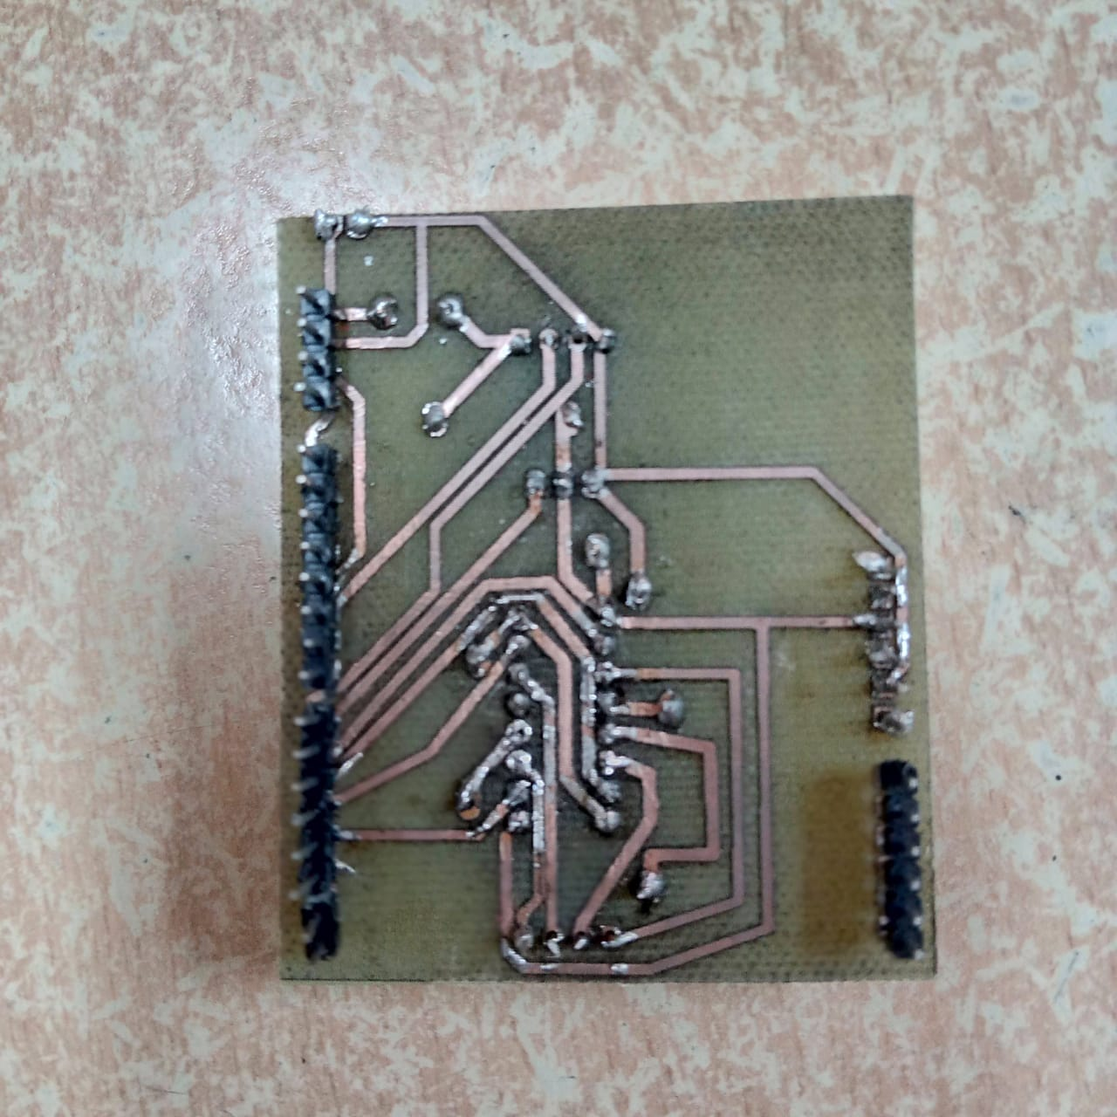
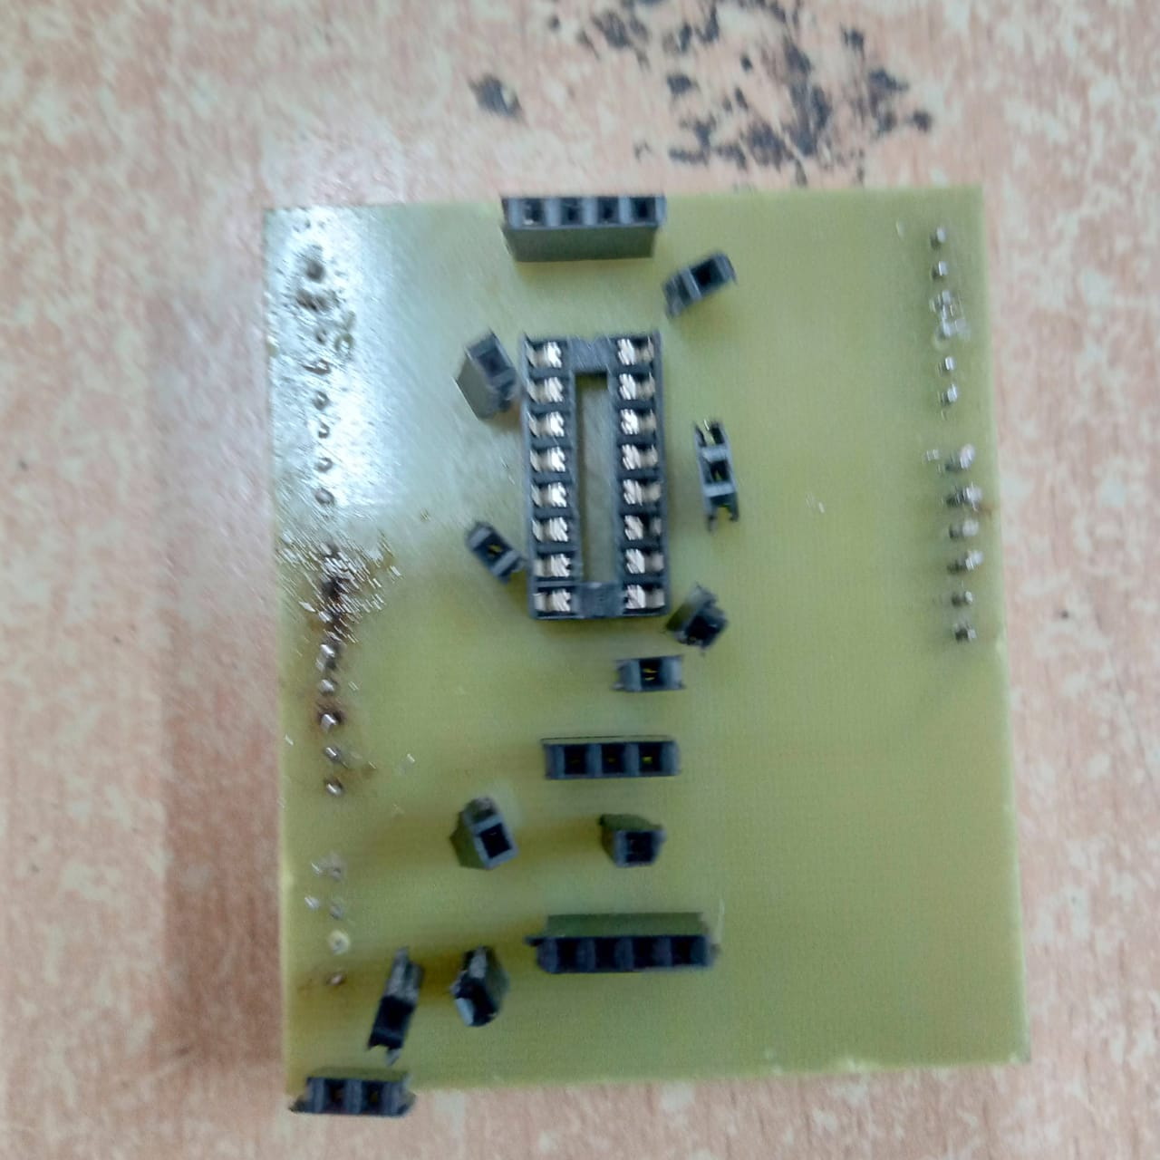
FINAL PCB BOARD

Slide 18
RESULT
Through our design and implementation of our proposed system we were able to achieve the following as results:
Pillbot was designed and controlled through voice commands given by the user who is operating the project through the mobile app created using MIT app Inventor.
The bot was able to navigate to the specified rooms while carrying and delivering the pills.
A PCB board for the same circuit implementation was designed to reduce the connection
complexities and to add ingenuity to the project.
CONCLUSION
Thus, we have designed a robot prototype that delivers medicines to quarantined rooms using Arduino Uno and IR sensors. It receives the commands given to the App through Bluetooth module.

Slide 19
REFERENCES
Aditya Chaudhry, Manas Batra, Prakhar Gupta, Sahil Lamba, Suyash Gupta ‘ARDUINO BASED VOICE CONTROLLED ROBOT’ in 2019 International Conference on Computing, Communication, and Intelligent Systems (ICCCIS)
PILLBOT: Non-Contact Medicine Dispensing System for Patients in Quarantine: Ms. Nanditha Krishna, Ms. R Navya Sree, Ms. Rajeshwari Sajith, Mr. S Kosal Ramji, Ms. Sheetal Ramesh in 2021 6th International Conference on Recent Trends on Electronics, Information, Communication & Technology (RTEICT), August 27th & 28th 2021

